Slide 1
Year 5 – Week 5 – Converting Units – Step 1
About This Resource:
This PowerPoint has been designed to support your teaching of this small step from the planning. It includes a starter activity suitable for your group and an example of each question from the Varied Fluency and Reasoning and Problem Solving resources also provided in the worksheets. I recommend that you work through the PowerPoint each day and complete the work that goes with it.

Slide 2
Year 5/6 – Summer Block 1 – Converting Units
Step 1
Year 5: Kilograms and Kilometres

Slide 3
Introduction
Tuesday 21st April 2020
Complete the boxes to show what you must do
to convert these units of measure.
km
m
g
kg
Y5

Slide 4
Introduction
Complete the boxes to show what you must do
to convert these units of measure.
x 1,000
÷ 1,000
km
m
g
kg
÷ 1,000
x 1,000
Y5

Slide 5
Varied Fluency 1
Check each of the conversions and correct any that are wrong.
6,000m = 6.0km | 900m = 9.0km
7.5km = 7,500m | 4.7kg = 4,070g
50,000g = 5.5kg | 150g = 15.0kg
200m = 2.0km | 8.1kg = 810g
1,600g = 1.6kg | 1,900m = 1.9km
Y5

Slide 6
Varied Fluency 1
Check each of the conversions and correct any that are wrong.
6,000m = 6.0km | 900m = 0.9km 9,000m = 9km
7.5km = 7,500m | 4.7kg = 4,700g 4.07kg = 4,070g
50,000g = 50kg 5,500g = 5.5kg | 150g = 0.15kg 15,000g = 15kg
200m = 0.2km 2,000m = 2.0km | 8.1kg = 8,100g 0.81kg = 810g
1,600g = 1.6kg | 1,900m = 1.9km
Y5

Slide 7
Varied Fluency 2
True or false?
4kg > 3,500g |  | 21kg > 2,010g
7.3km = 730m |  | 2,900m > 2.9km
Y5

Slide 8
Varied Fluency 2
True or false?
4kg > 3,500g |  | 21kg > 2,010g
True |  | True
7.3km = 730m |  | 2,900m > 2.9km
False ( > ) |  | False ( = )
Y5

Slide 9
Varied Fluency 3
Select a number from the box to make these statements
correct. Add the correct unit of measurement.
5kg < __________ | __________ > 16kg
7.1km > __________ | 3,900m = __________
3.9 | 17,000 | 5,300 | 4,800
Y5

Slide 10
Varied Fluency 3
Wednesday 22nd April 2020
Select a number from the box to make these statements
correct. Add the correct unit of measurement.
5kg < __________ | __________ > 16kg
7.1km > __________ | 3,900m = __________
5,300g
17,000g
4,800m
3.9km
3.9 | 17,000 | 5,300 | 4,800
Y5

Slide 11
Varied Fluency 4
Mike runs of 1km.
How many metres does he run?
9
10
Y5

Slide 12
Varied Fluency 4
Mike runs of 1km.
How many metres does he run?
900m
1km = 1,000m
1,000m ÷ 10 = 100m
100m x 9 = 900m
9
10
Y5

Slide 13
Problem Solving 1
Thursday 23rd April 2020
Complete the circles so that each line adds up to 7,000g in every direction. Give your answer in kilograms.
0.5kg
2,400g
2.7kg
400g
Y5

Slide 14
Problem Solving 1
Complete the circles so that each line adds up to 7,000g in every direction. Give your answer in kilograms.
0.5kg
4.1kg
2,400g
0.2kg
3.9kg
2.7kg
400g
Y5

Slide 15
Problem Solving 2
Using the cards below, create as many
comparisons as you can.
5,500m
4.3km
2,300m
<
>
Y5

Slide 16
Problem Solving 2
Using the cards below, create as many
comparisons as you can.
5,500m
4.3km
2,300m
<
>
4.3km < 5,500m 2,300m < 5,500m 2,300m < 4.3km | 5,500m > 4.3km 5,500m > 2,300m 4.3km > 2,300m
Y5

Slide 17
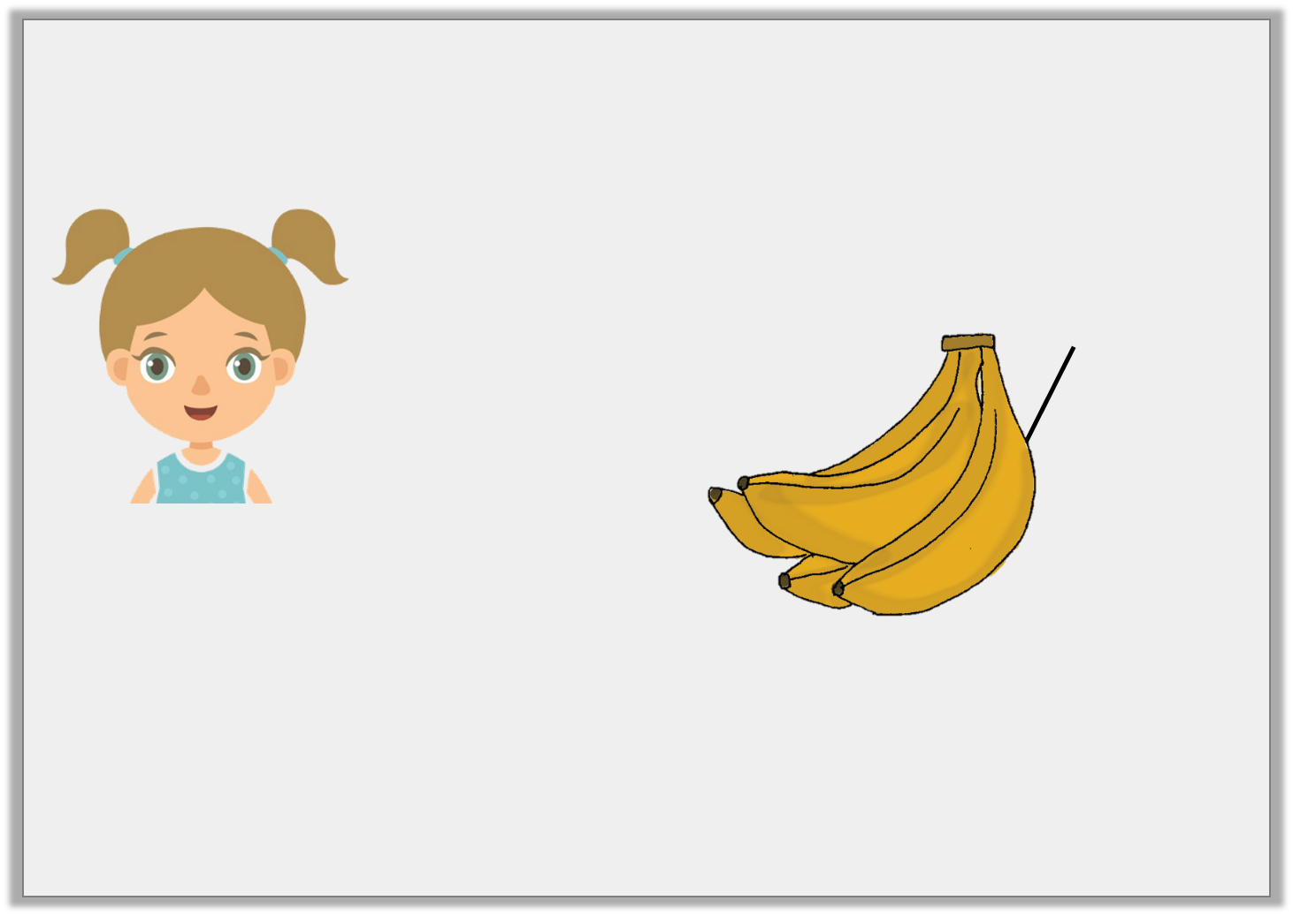
Reasoning 1
Friday 24th April 2020
Each bunch of bananas weighs 550g.
Is Kim right?
Explain how you know.
I have £3.50 to spend, so I can buy 2 bunches of bananas.
£3.50 per kg
Y5

Slide 18
Reasoning 1
Each bunch of bananas weighs 550g.
Is Kim right?
Explain how you know.
Kim is incorrect because…
I have £3.50 to spend, so I can buy 2 bunches of bananas.
£3.50 per kg
Y5

Slide 19
Reasoning 1
Each bunch of bananas weighs 550g.
Is Kim right?
Explain how you know.
Kim is incorrect because 2 bunches would be 550g x 2 = 1,100g = 1.1kg. Kim only has enough money for 1kg of bananas.
I have £3.50 to spend, so I can buy 2 bunches of bananas.
£3.50 per kg
Y5

