Slide 1
Year 6 – Week 5 – Converting Units – Step 1
About This Resource:
This PowerPoint has been designed to support your teaching of this small step from the planning. It includes a starter activity suitable for your group and an example of each question from the Varied Fluency and Reasoning and Problem Solving resources also provided in the worksheets. I recommend that you work through the PowerPoint each day and complete the work that goes with it.

Slide 2
Year 5/6 – Summer Block 1 – Converting Units
Tuesday 21st April 2020
Step 1
Year 6: Metric Measures

Slide 3
Introduction
kilogram
kg
ml
centimetres
kilometres
km
cm
mililitres
Y6

Slide 4
Introduction
kilogram
kg
ml
centimetres
kilometres
km
cm
mililitres
Y6

Slide 5
Varied Fluency 1
Match the units of measurement to the correct purpose.
weight
centilitres
litres
mm
grams
length
volume
Y6

Slide 6
Varied Fluency 1
Match the units of measurement to the correct purpose.
weight
centilitres
litres
mm
grams
length
volume
Y6

Slide 7
Varied Fluency 2
Find the odd one out.
A. 5km
B. 127cm
C. 2.5kg
D. The length of a football pitch
Y6

Slide 8
Varied Fluency 2
Find the odd one out.
2.5kg.
The others are all measurements of length.
A. 5km
B. 127cm
C. 2.5kg
D. The length of a football pitch
Y6

Slide 9
Varied Fluency 3
Wednesday 22nd April 2020
Which of the following objects could be 100m long?
hall
running track
bench
Y6

Slide 10
Varied Fluency 3
Which of the following objects could be 100m long?
Running track
hall
running track
bench
Y6

Slide 11
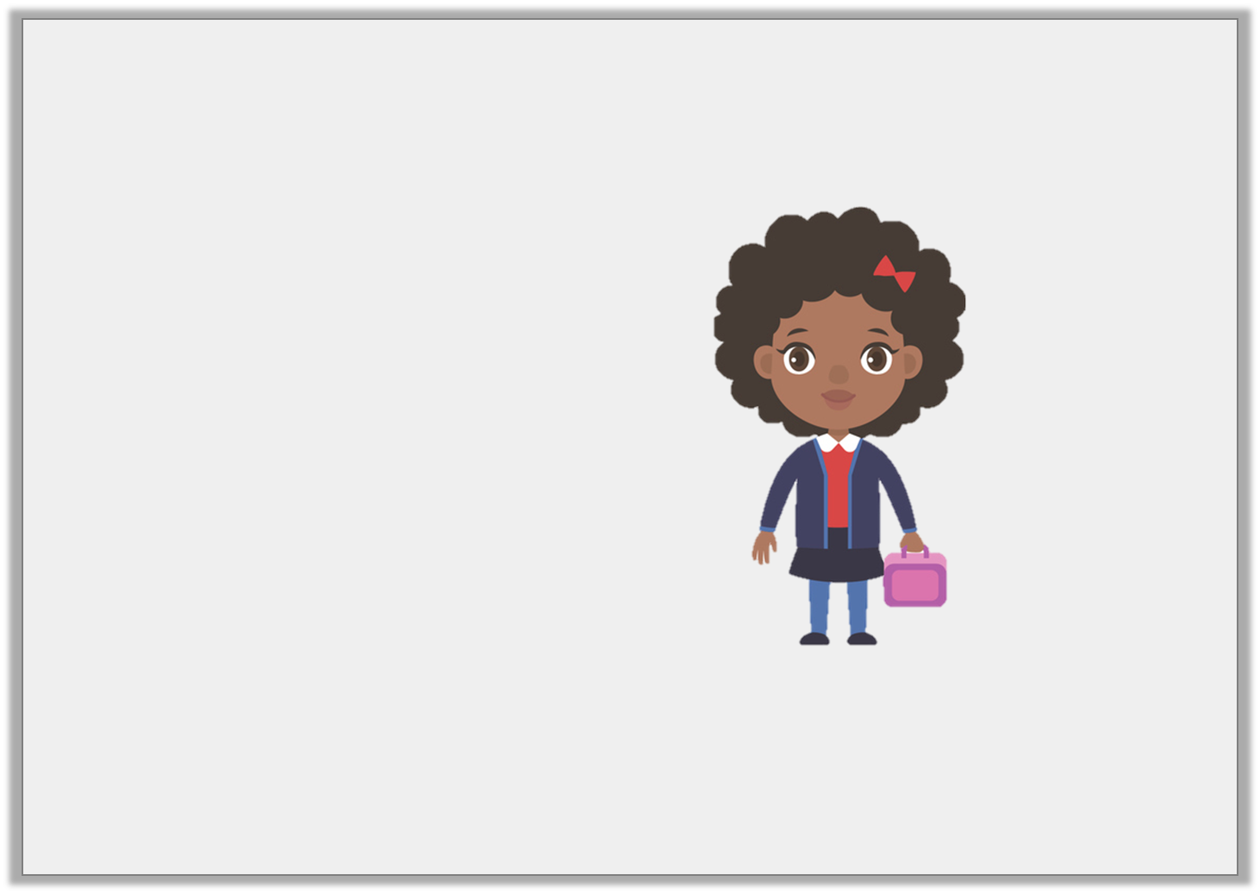
Varied Fluency 4
Match the most accurate estimates to the item.
125cm tall
weighs 20g
weighs 20kg
Y6

Slide 12
Varied Fluency 4
Match the most accurate estimates to the item.
125cm tall and weighs 20kg.
125cm tall
weighs 20g
weighs 20kg
Y6

Slide 13
Reasoning 1
Thursday 23rd April 2020
Felix is measuring the height of his classmates’ and recording his results.
He has forgotten to write the unit of measurement.
Which unit measurement could he be using for each length? Convince me.
Peter | 1.1
Lizzy | 102
Isla | 0.9
Y6

Slide 14
Reasoning 1
Felix is measuring the height of his classmates’ and recording his results.
He has forgotten to write the unit of measurement.
Which unit measurement could he be using for each length? Convince me.
All the heights are similar and in a class of children, there wouldn’t be too much difference in their heights.
Peter | 1.1 | m
Lizzy | 102 | cm
Isla | 0.9 | m
Y6

Slide 15
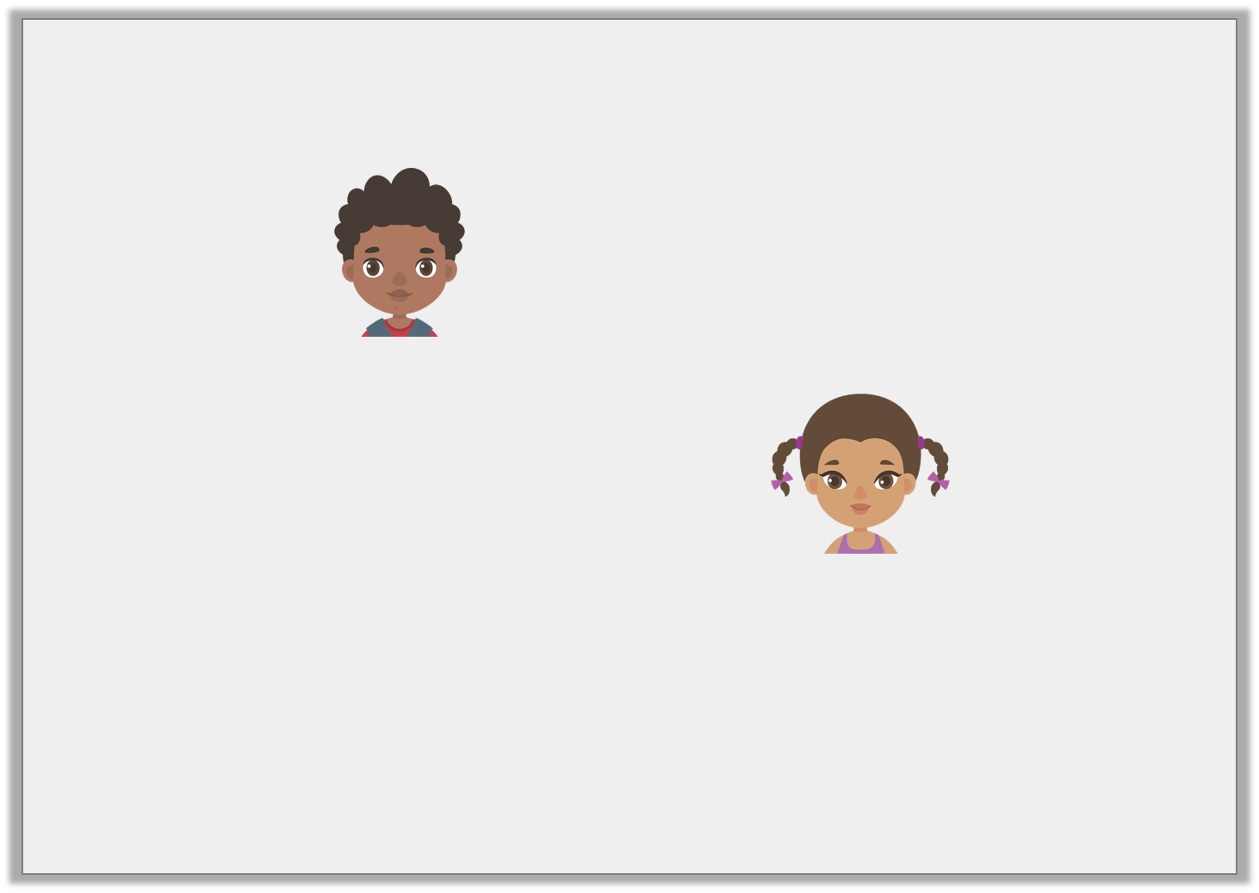
Reasoning 2
The children are estimating how far it is to walk to assembly.
Who do you agree with and why?
I think it will be around 117m.
Sam
I think it will be around 117cm.
India
Y6

Slide 16
Reasoning 2
The children are estimating how far it is to walk to assembly.
Who do you agree with and why?
I agree with Sam because…
I think it will be around 117m.
Sam
I think it will be around 117cm.
India
Y6

Slide 17
Reasoning 2
The children are estimating how far it is to walk to assembly.
Who do you agree with and why?
I agree with Sam because metres is the correct unit of measure for this distance. 117cm is not far enough.
I think it will be around 117m.
Sam
I think it will be around 117cm.
India
Y6

Slide 18
Problem Solving 1
Friday 24th April 2020
If we know that one bottle of lemonade has volume of 1 litre, make estimates for the following:
a bath
a sink
a can of drink
a cup of coffee
Y6

Slide 19
Problem Solving 1
If we know that one bottle of lemonade has volume of 1 litre, make estimates for the following:
Estimates may vary.
a bath | 80L
a sink | 10L
a can of drink | 0.5L
a cup of coffee | 0.5L
Y6

