Slide 1
Year 3/4 – Summer Block 5 – Mass and Capacity
25.03.20
Year 3:
LO: I can measure mass 1 using reasoning and problem solving
© Classroom Secrets Limited 2018

Slide 2
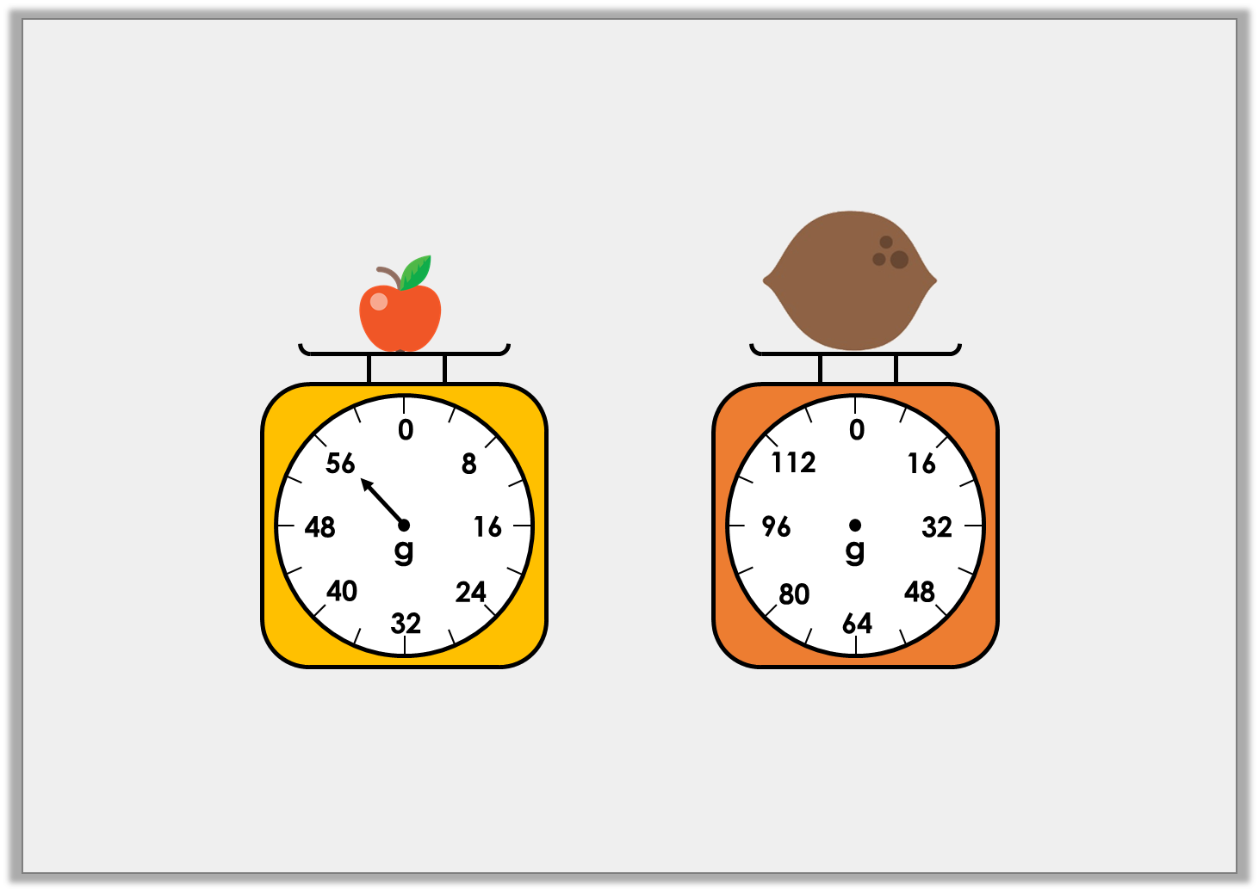
Problem Solving 1
If two apples weigh the same as one coconut,
draw an arrow on the scale to show the weight of the coconut.
Y3
© Classroom Secrets Limited 2018

Slide 3
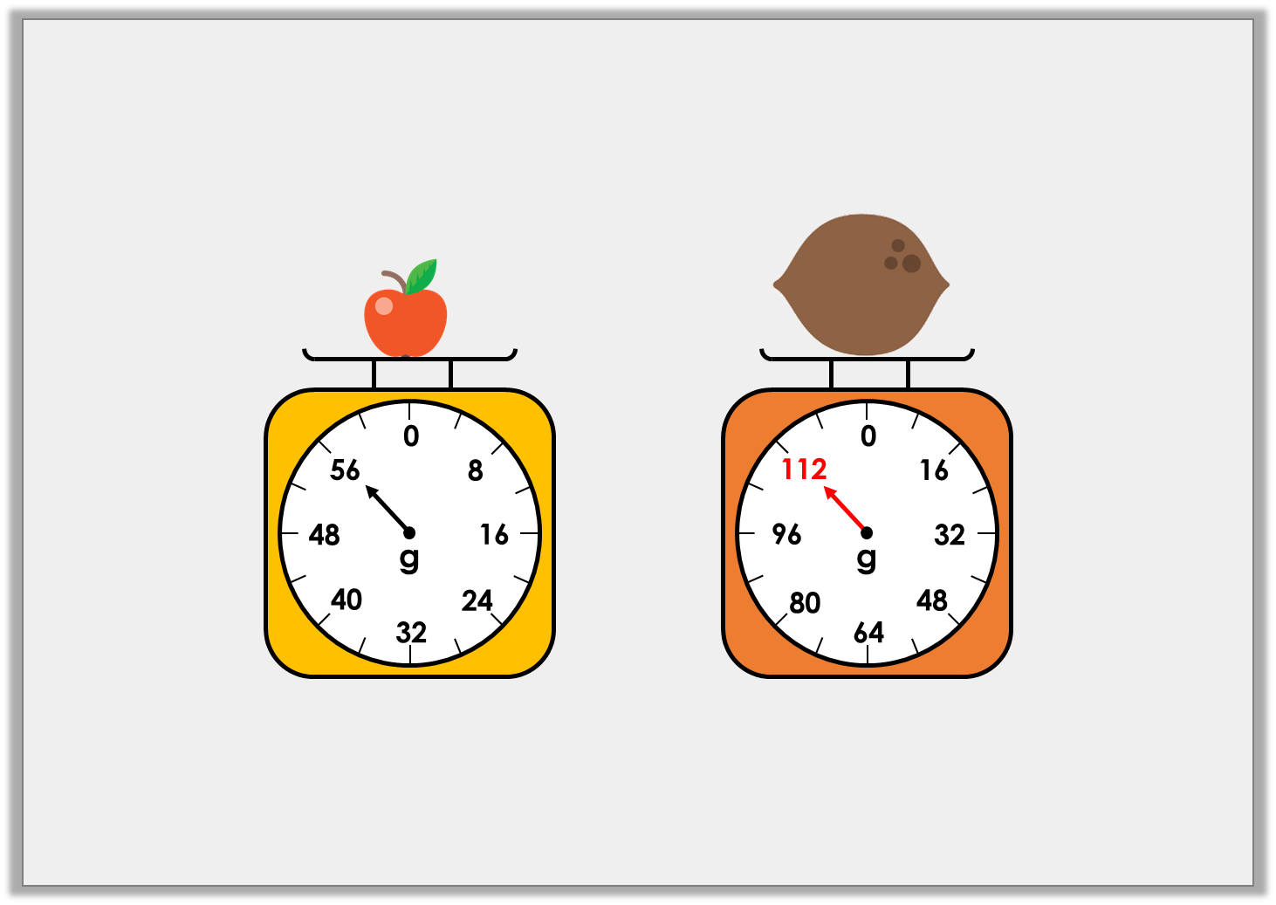
Problem Solving 1
If two apples weigh the same as one coconut,
draw an arrow on the scale to show the weight of the coconut.
Y3
© Classroom Secrets Limited 2018

Slide 4
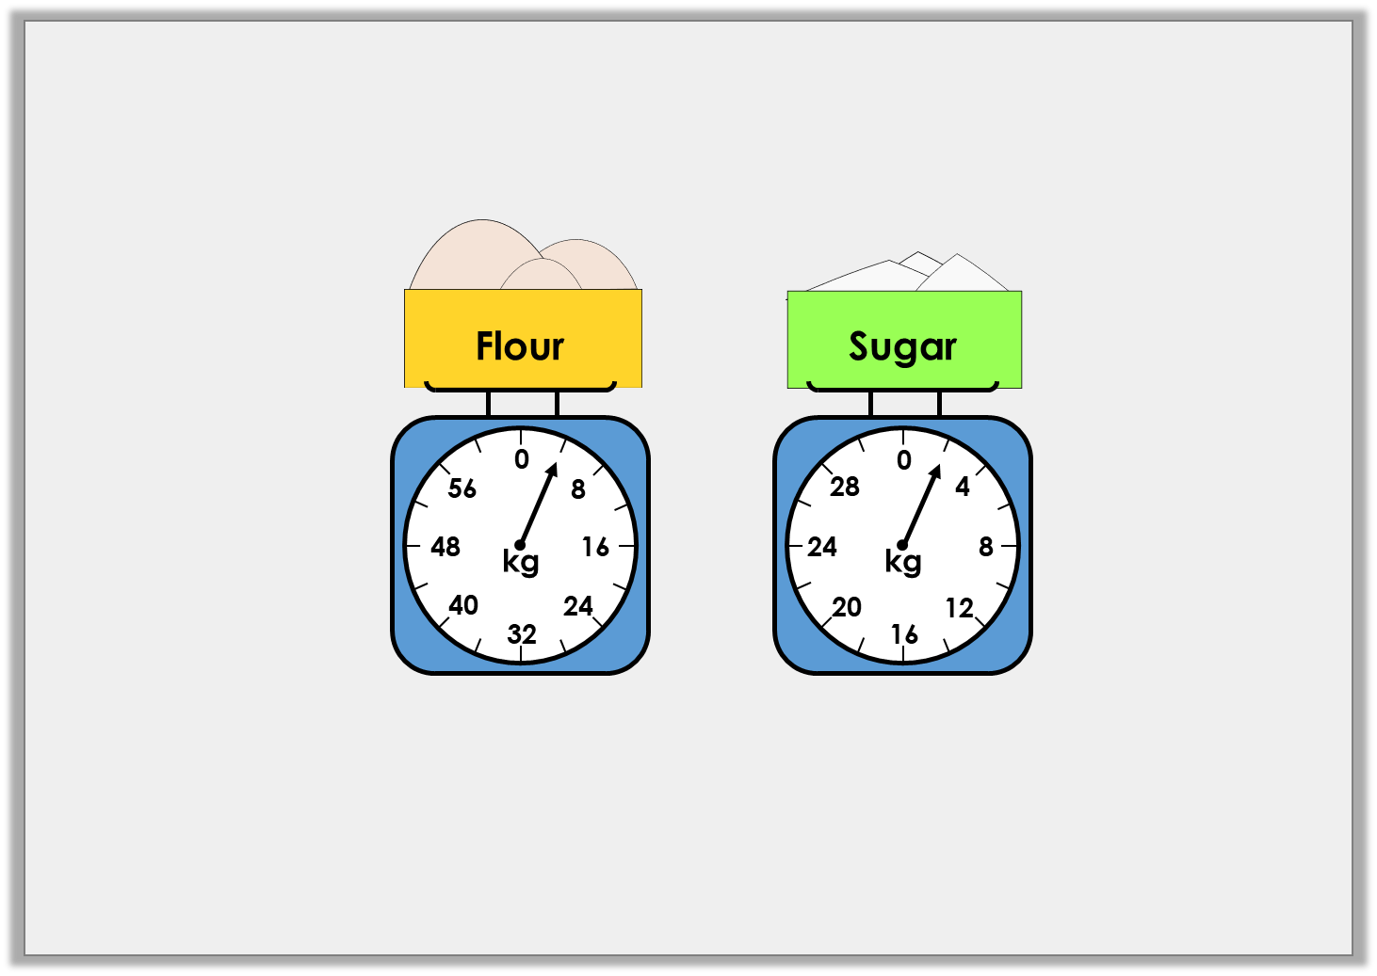
Problem Solving 2
Lizzie is making cakes. She needs 6kg of flour and 6kg of sugar.
How much more of each ingredient does she need?
Y3
© Classroom Secrets Limited 2018

Slide 5
Problem Solving 2
Lizzie is making cakes. She needs 6kg of flour and 6kg of sugar.
How much more of each ingredient does she need?
2kg of flour
4kg of sugar
Y3
© Classroom Secrets Limited 2018

Slide 6
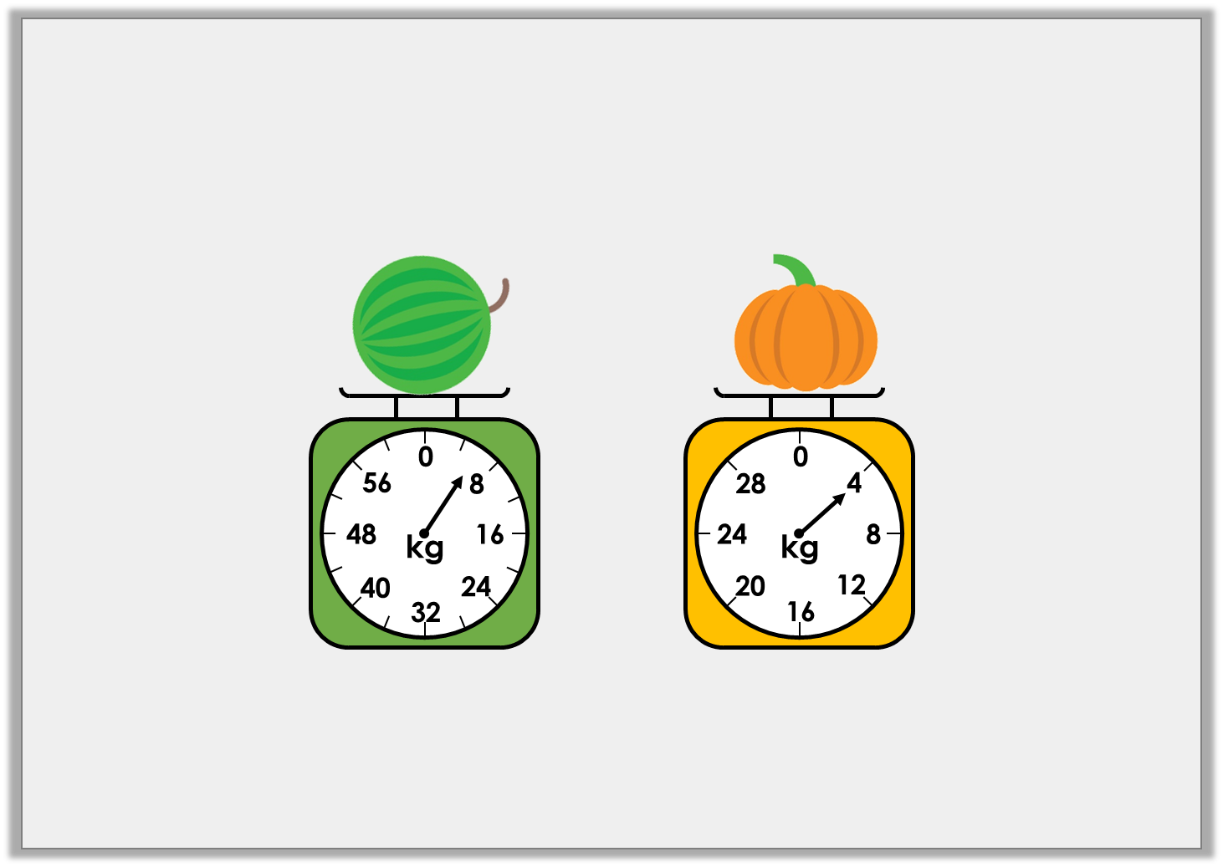
Reasoning 1
Joanne is weighing different items.
She says the watermelon is heavier because the arrow
on the scale is further away from zero.
Is she correct? Explain how you know.
Y3
© Classroom Secrets Limited 2018

Slide 7
Reasoning 1
Joanne is weighing different items.
She says the watermelon is heavier because the arrow
on the scale is further away from zero.
Is she correct? Explain how you know.
Joanne is incorrect because…
Y3
© Classroom Secrets Limited 2018

Slide 8
Reasoning 1
Joanne is weighing different items.
She says the watermelon is heavier because the arrow
on the scale is further away from zero.
Is she correct? Explain how you know.
Joanne is incorrect because the watermelon weighs 6kg and the pumpkin weighs 4kg. The scales increase in different increments.
Y3
© Classroom Secrets Limited 2018

