Slide 1
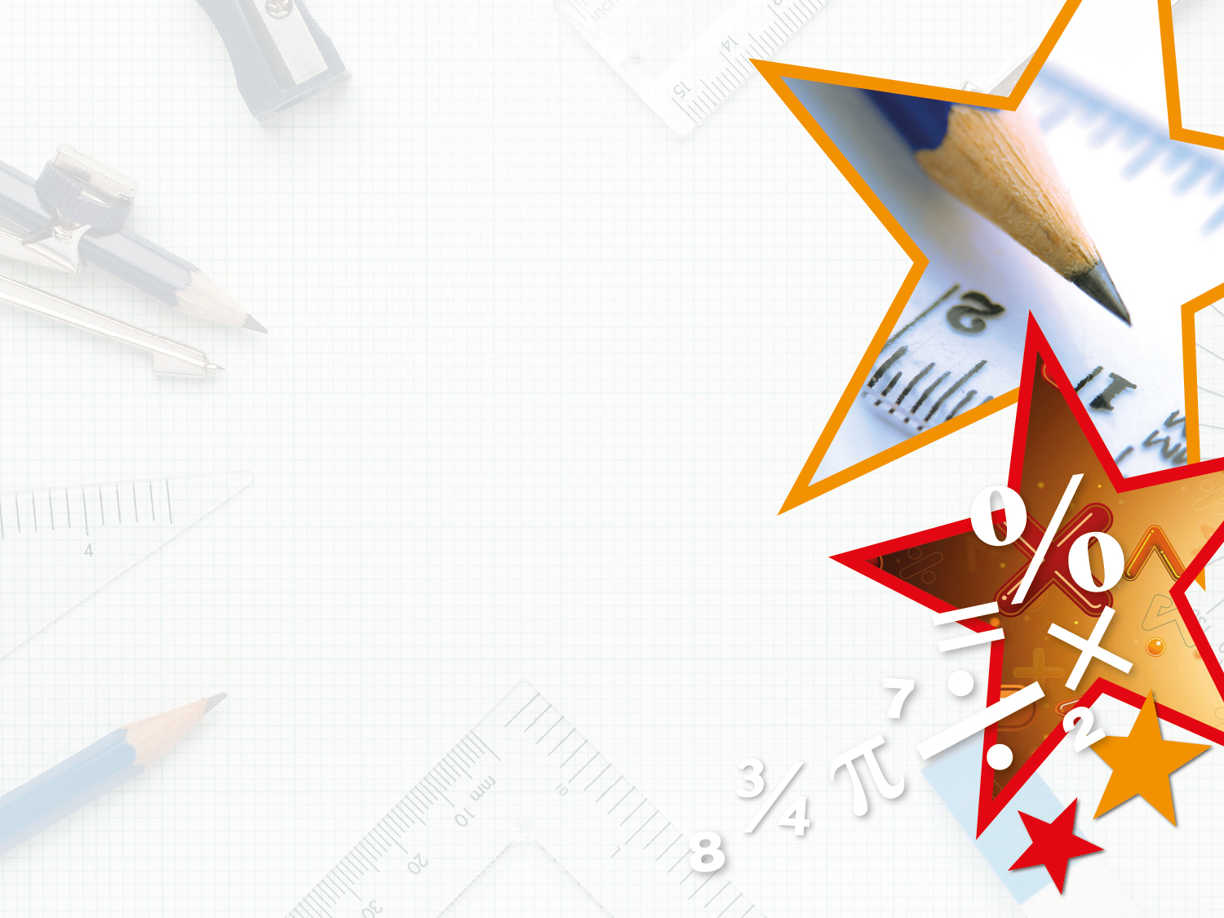

Year 3/4 – Summer Block 5 – Mass and Capacity
26.03.20
Step 2
Year 3: I can measure mass 2
© Classroom Secrets Limited 2018
© Classroom Secrets Limited 2018

Slide 2
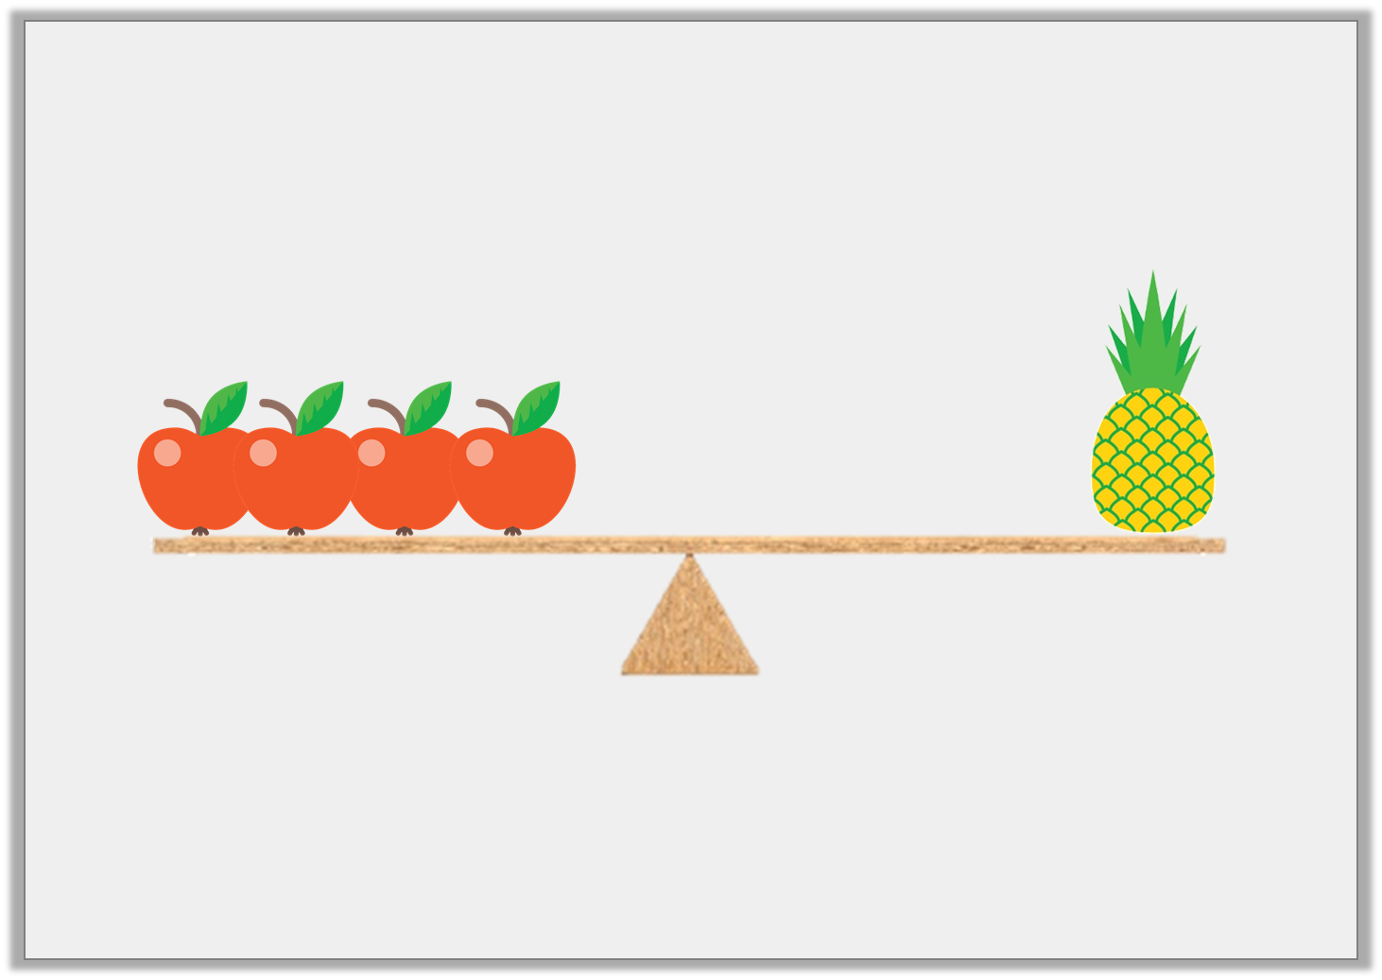
Introduction
Sasha is using scales to measure mass.
The pineapple weighs 60g.
How much does one apple weigh?
Y3
© Classroom Secrets Limited 2018
© Classroom Secrets Limited 2018

Slide 3
Introduction
Sasha is using scales to measure mass.
The pineapple weighs 60g.
How much does one apple weigh?
15kg
Y3
© Classroom Secrets Limited 2018
© Classroom Secrets Limited 2018

Slide 4
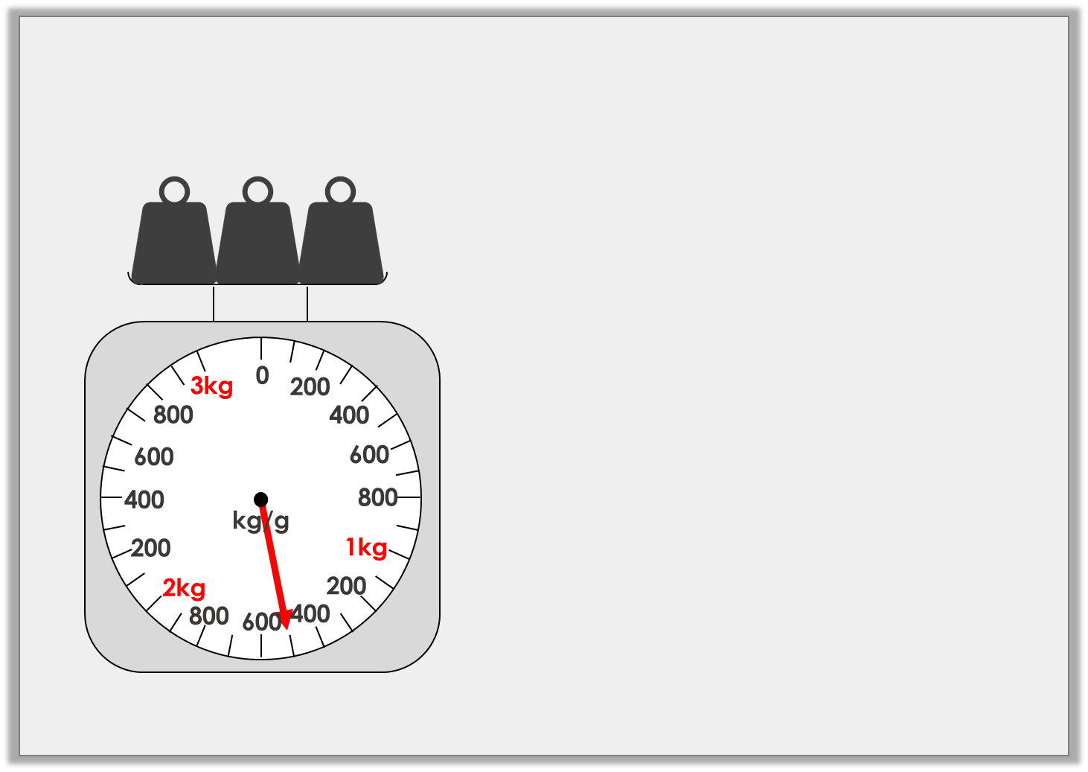
Varied Fluency 1
What mass is shown on the scales?
 | kg |  | g
Y3
© Classroom Secrets Limited 2018
© Classroom Secrets Limited 2018

Slide 5
Varied Fluency 1
What mass is shown on the scales?
1 | kg | 500 | g
Y3
© Classroom Secrets Limited 2018
© Classroom Secrets Limited 2018

Slide 6
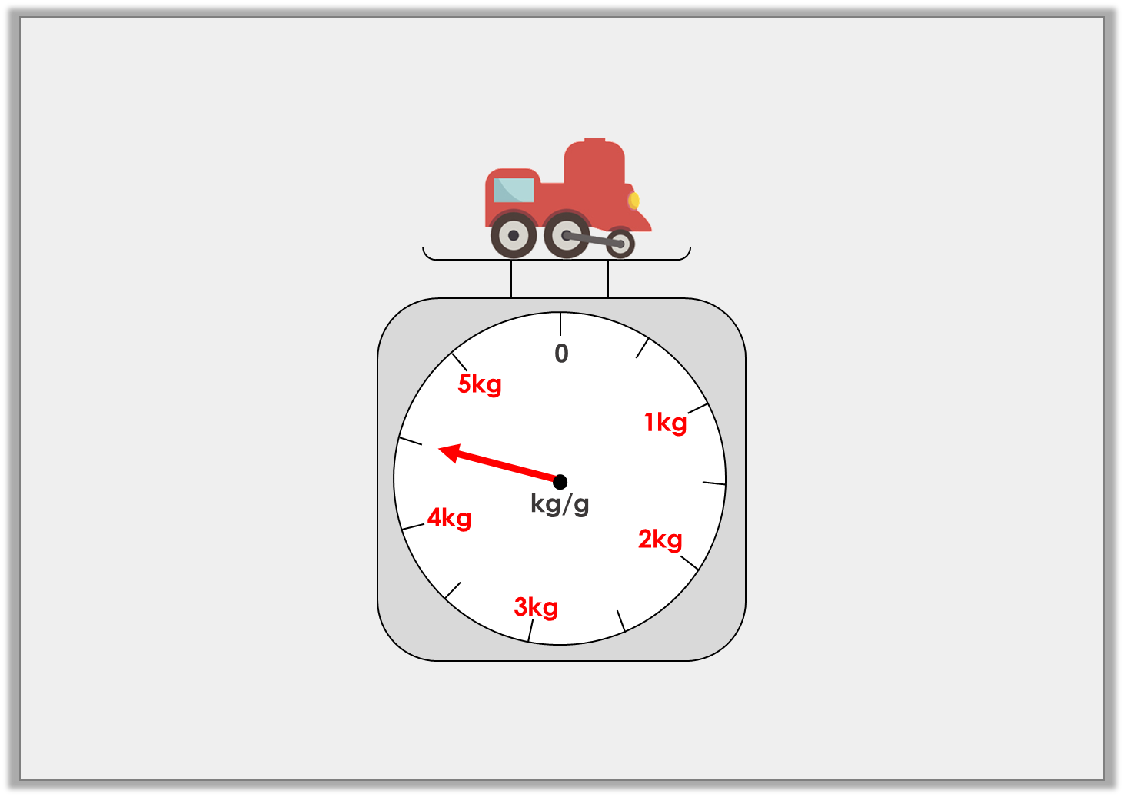
Varied Fluency 2
True or false? The train weighs 3kg and 500g.
Y3
© Classroom Secrets Limited 2018
© Classroom Secrets Limited 2018

Slide 7
Varied Fluency 2
True or false? The train weighs 3kg and 500g.
False, the arrow is pointing between 4kg and 5kg, which is 4kg and 500g.
Y3
© Classroom Secrets Limited 2018
© Classroom Secrets Limited 2018

Slide 8
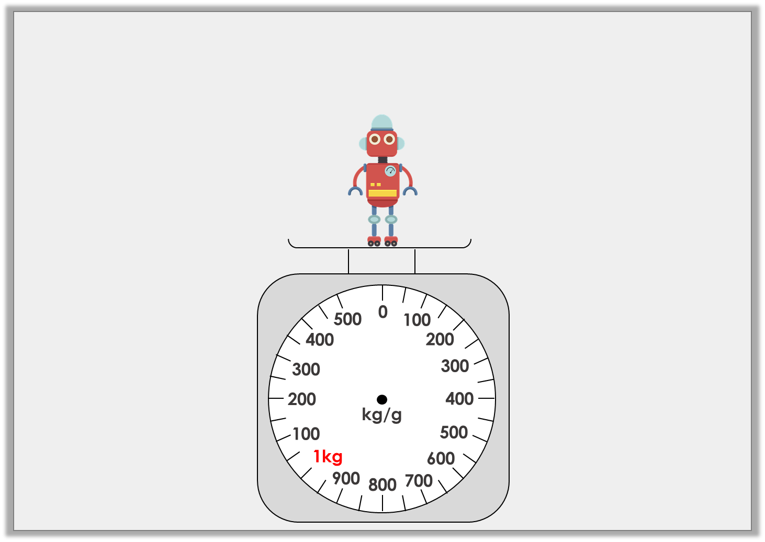
Varied Fluency 3
Draw an arrow on the scales to show that the robot weighs
1kg and 250g.
Y3
© Classroom Secrets Limited 2018

Slide 9
Varied Fluency 3
Draw an arrow on the scales to show that the robot weighs
1kg and 250g.
Y3
© Classroom Secrets Limited 2018

Slide 10
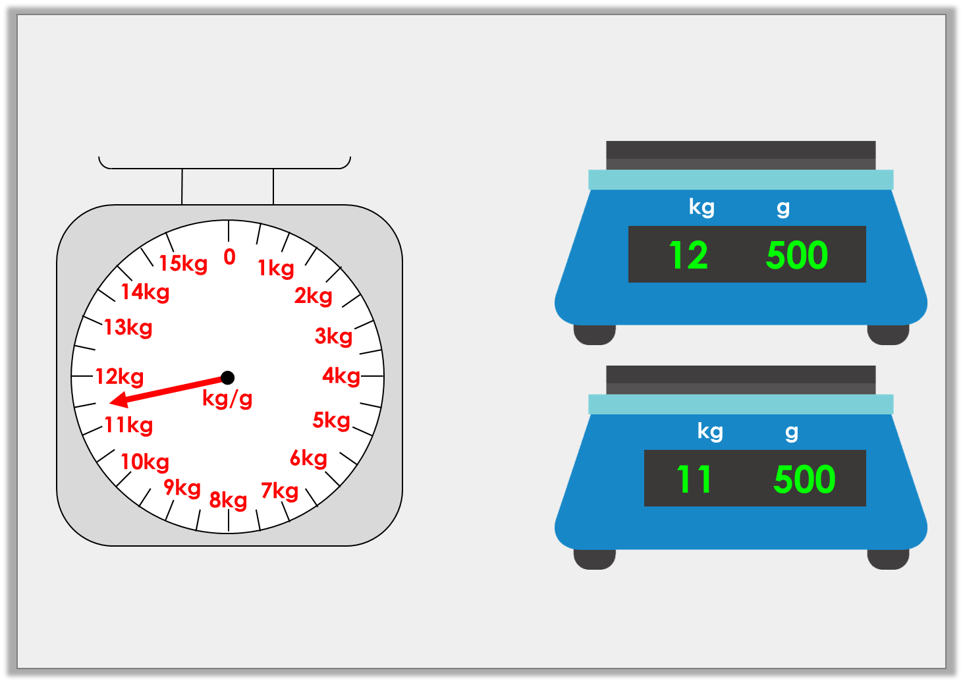
Varied Fluency 4
Match the mass on the scales to the correct digital scale.
A
B
Y3
© Classroom Secrets Limited 2018

Slide 11
Varied Fluency 4
Match the mass on the scales to the correct digital scale.
A
B
Y3
© Classroom Secrets Limited 2018

