Slide 1
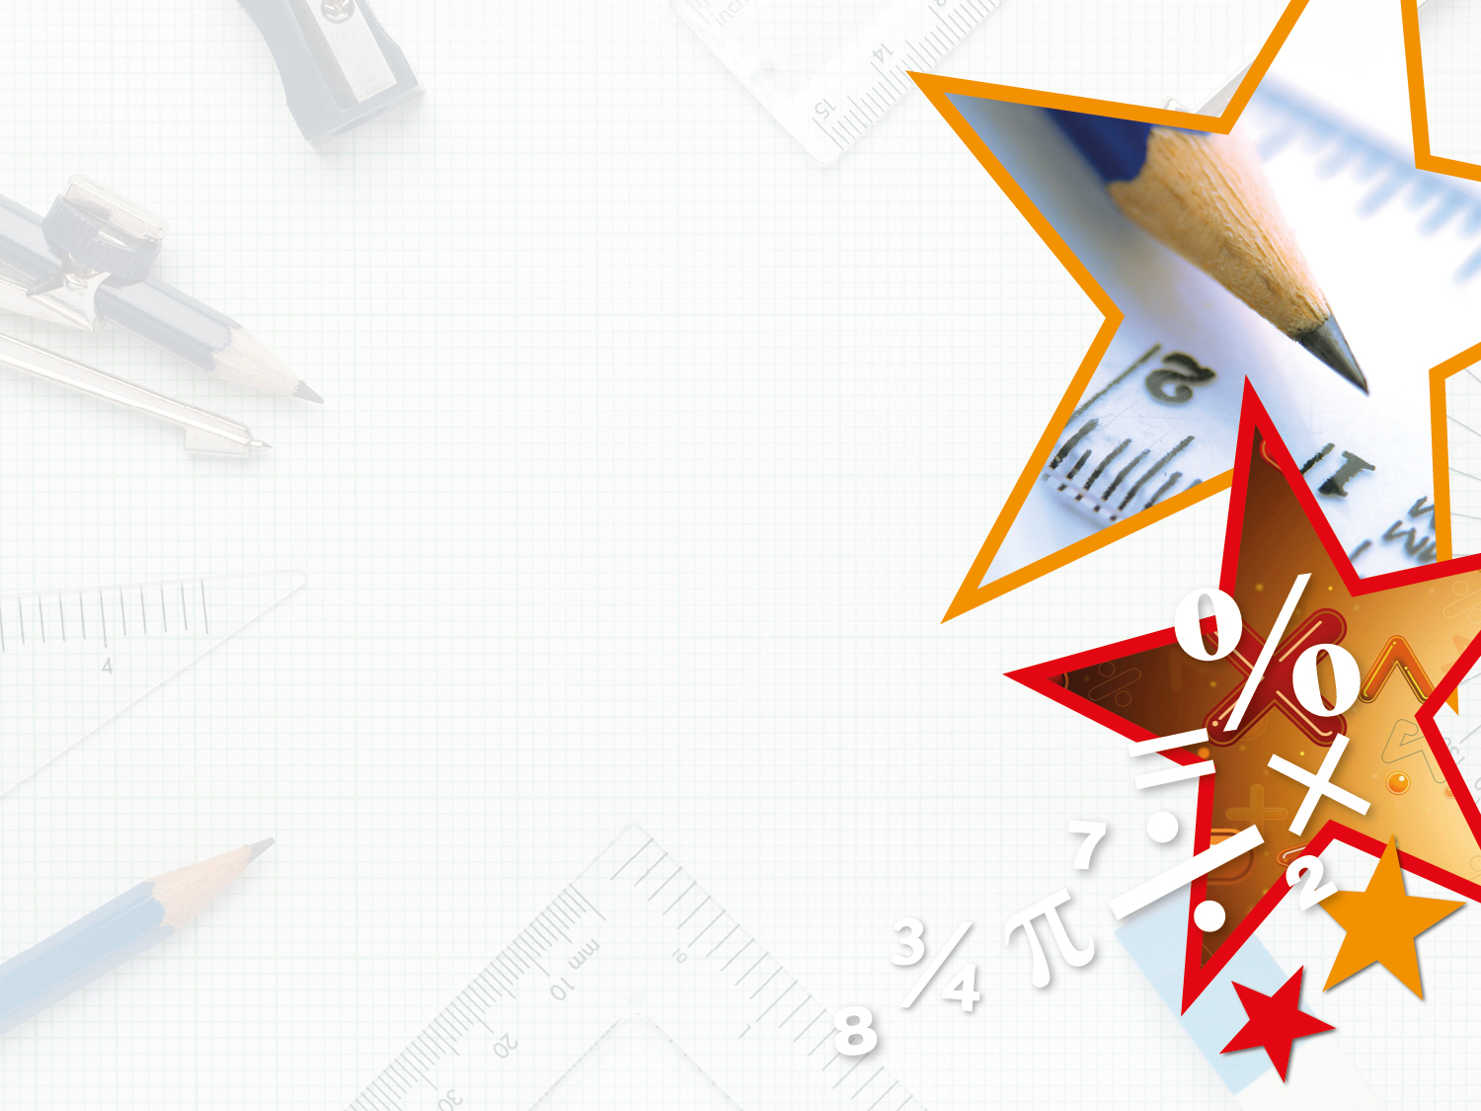

Year 3/4 – Summer Block 5 – Mass and Capacity
Step 2 –
Year 3: I can measure mass 2 using reasoning and problem-solving
© Classroom Secrets Limited 2018
© Classroom Secrets Limited 2018

Slide 2
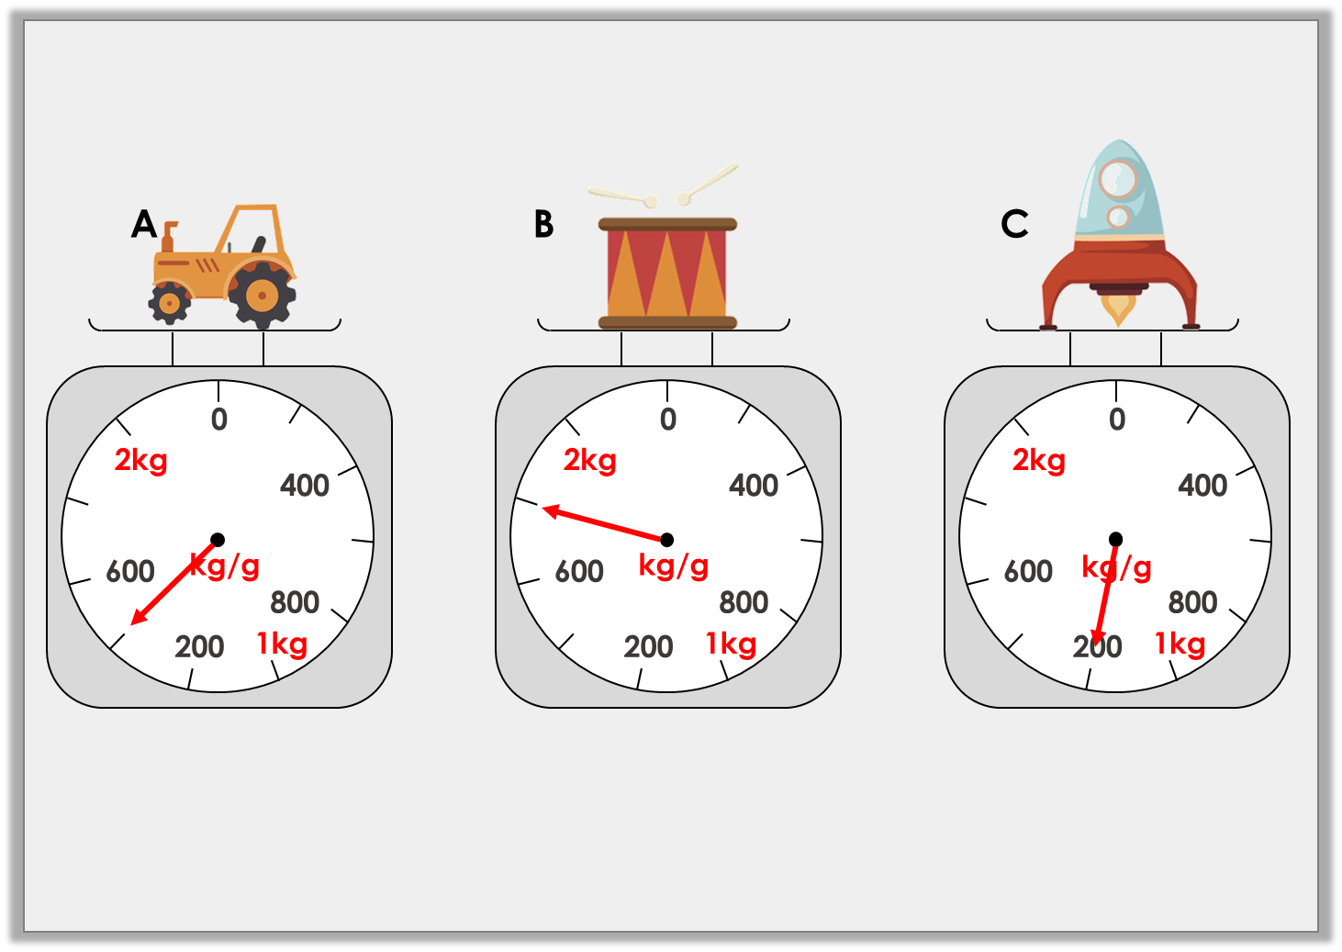
Reasoning 1
Which scale shows the heaviest weight?
Explain your answer.
Y3
© Classroom Secrets Limited 2018

Slide 3
Reasoning 1
Which scale shows the heaviest weight?
Explain your answer.
B because…
Y3
© Classroom Secrets Limited 2018

Slide 4
Reasoning 1
Which scale shows the heaviest weight?
Explain your answer.
B because 1kg and 800g is heavier than 1kg and 400g and 1kg and 200g.
1kg and 400g
1kg and 800g
1kg and 200g
Y3
© Classroom Secrets Limited 2018

Slide 5
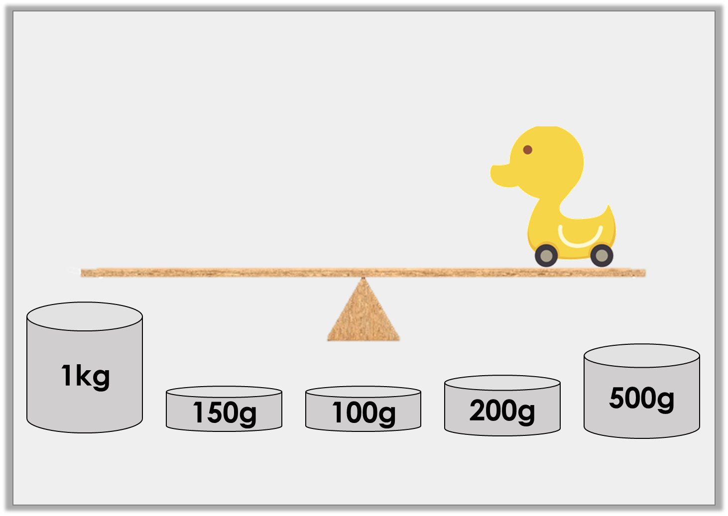
Problem Solving 1
Which weights will balance the scales if the duck weighs 1kg and 350g?
Y3
© Classroom Secrets Limited 2018

Slide 6
Problem Solving 1
Which weights will balance the scales if the duck weighs 1kg and 350g?
1kg + 200g + 150g
Y3
© Classroom Secrets Limited 2018

Slide 7
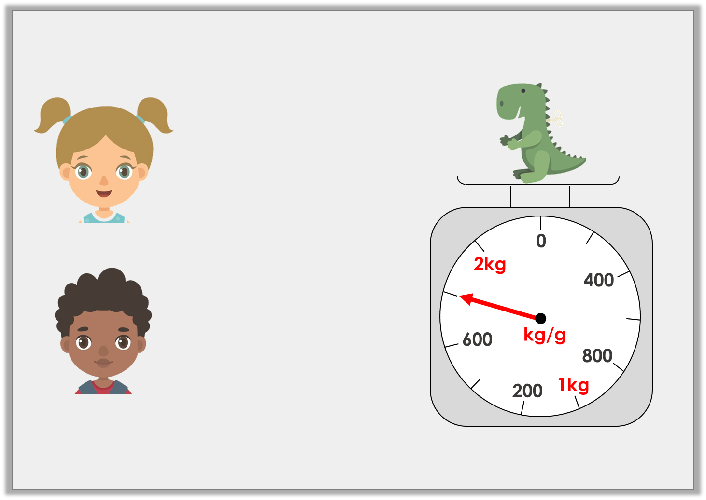
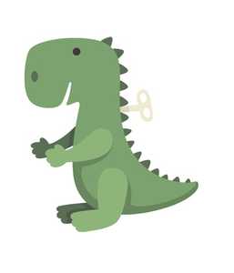
Reasoning 2
Who is correct?
Explain why.
The dinosaur weighs 1kg and 800g.
Martha
The dinosaur weighs 1kg and 400g.
Coleman
Y3
© Classroom Secrets Limited 2018

Slide 8
Reasoning 2
Who is correct?
Explain why.
Martha is correct because…
The dinosaur weighs 1kg and 800g.
Martha
The dinosaur weighs 1kg and 400g.
Coleman
Y3
© Classroom Secrets Limited 2018

Slide 9
Reasoning 2
Who is correct?
Explain why.
Martha is correct because the scale show 1kg and 800g.
The dinosaur weighs 1kg and 800g.
Martha
The dinosaur weighs 1kg and 400g.
Coleman
Y3
© Classroom Secrets Limited 2018

