Slide 1
31.03.20
L.O: to solve problems involving the calculations of percentages

Slide 2
Introduction
Match the answers to the correct question.
210 |  | 75% of 160
120 |  | 10% of 37
80 |  | 40% of 200
3.7 |  | 60% of 350
Y6

Slide 3
Introduction
Match the answers to the correct question.
210 |  | 75% of 160
120 |  | 10% of 37
80 |  | 40% of 200
3.7 |  | 60% of 350
Y6

Slide 4
Varied Fluency 1
Increase the following numbers by 35%.
A) 300
B) 60
C) 50
Y6

Slide 5
Varied Fluency 1
Increase the following numbers by 35%.
A) 300 35% of 300 = 105; 300 + 105 = 405
B) 60 35% of 60 = 21; 60 + 21 = 81
C) 50 35% of 50 = 17.5; 50 + 17.5 = 67.5
Y6

Slide 6
Varied Fluency 2
Jaxon is reducing the prices of items in his shop by 20%.
Calculate the new prices.
£10.50 | £15 | £12
Y6

Slide 7
Varied Fluency 2
Jaxon is reducing the prices of items in his shop by 20%.
Calculate the new prices.
Yo-yo: 80% of £10.50 = £8.40
House: 80% of £15 = £12.00
Windmill: 80% of £12 = £9.60
£10.50 | £15 | £12
Y6

Slide 8
Varied Fluency 3
Iqra scored 60 in her maths test.
She made herself a target of scoring 15% more in her next test.
What does her score need to be to hit her target?
Y6

Slide 9
Varied Fluency 3
Iqra scored 60 in her maths test.
She made herself a target of scoring 15% more in her next test.
What does her score need to be to hit her target?
15% of 60 = 9
60 + 9 = 69
She needs to score at least 69
Y6

Slide 10
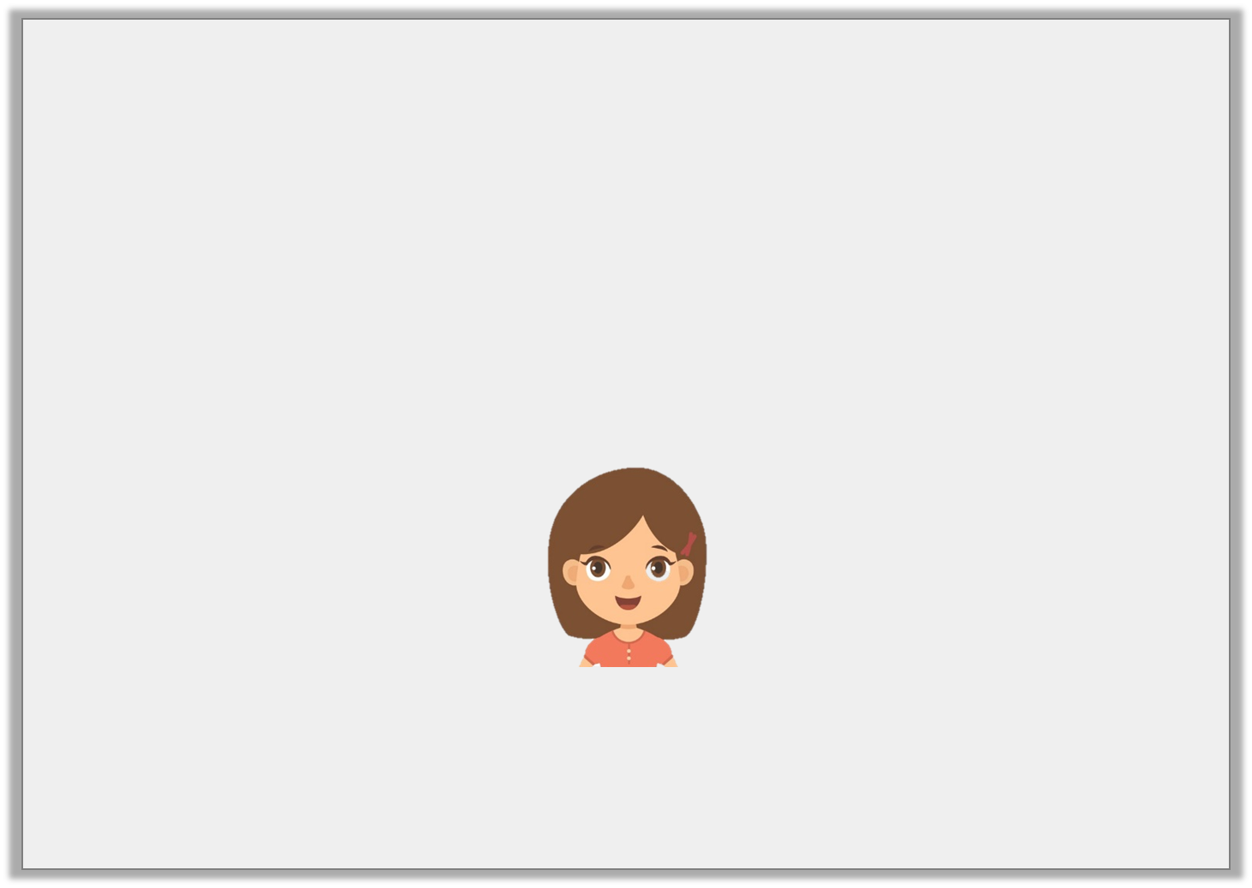
Varied Fluency 4
True or false?
A 5% decrease in price from £30 means there is £1 off.
Y6

Slide 11
Varied Fluency 4
True or false?
False. There is £1.50 off.
A 5% decrease in price from £30 means there is £1 off.
Y6

