Slide 1
Year 3/4 – Spring Block 4 – Decimals
27.03.20
Step 8:
Year 4: I can divide 2-digits by 10 using reasoning and problem-solving
© Classroom Secrets Limited 2019

Slide 2
Reasoning 1
Use your knowledge of dividing 2-digits
by 10 to find the odd one out.
Explain your reasoning.
10 | 20 | 30 | 40 | 50 | 60 | 70 | 80 | 90
1 | 2 | 3 | 4 | 5 | 6 | 7 | 8 | 9
0.1 | 0.2 | 0.3 | 0.4 | 0.5 | 0.6 | 0.7 | 0.8 | 0.9
A
tens | ones | tenths | hundredths
B
C 42
Y4
© Classroom Secrets Limited 2019

Slide 3
Reasoning 1
Use your knowledge of dividing 2-digits
by 10 to find the odd one out.
Explain your reasoning.
A is the odd one out because…
10 | 20 | 30 | 40 | 50 | 60 | 70 | 80 | 90
1 | 2 | 3 | 4 | 5 | 6 | 7 | 8 | 9
0.1 | 0.2 | 0.3 | 0.4 | 0.5 | 0.6 | 0.7 | 0.8 | 0.9
A
tens | ones | tenths | hundredths
B
C 42
Y4
© Classroom Secrets Limited 2019

Slide 4
Reasoning 1
Use your knowledge of dividing 2-digits
by 10 to find the odd one out.
Explain your reasoning.
A is the odd one out because C ÷ 10 = B
10 | 20 | 30 | 40 | 50 | 60 | 70 | 80 | 90
1 | 2 | 3 | 4 | 5 | 6 | 7 | 8 | 9
0.1 | 0.2 | 0.3 | 0.4 | 0.5 | 0.6 | 0.7 | 0.8 | 0.9
A
tens | ones | tenths | hundredths
B
C 42
Y4
© Classroom Secrets Limited 2019

Slide 5
Problem Solving 1
Use the cards to complete the number sentence. Find 3 possibilities.
5.3
16
3.5
72
10
7.2
1.6
53
 | ÷ |  | =
Y4
© Classroom Secrets Limited 2019

Slide 6
Problem Solving 1
Use the cards to complete the number sentence. Find 3 possibilities.
72 ÷ 10 = 7.2, 53 ÷ 10 = 5.3
5.3
16
3.5
72
10
7.2
1.6
53
16 | ÷ | 10 | = | 1.6
Y4
© Classroom Secrets Limited 2019

Slide 7
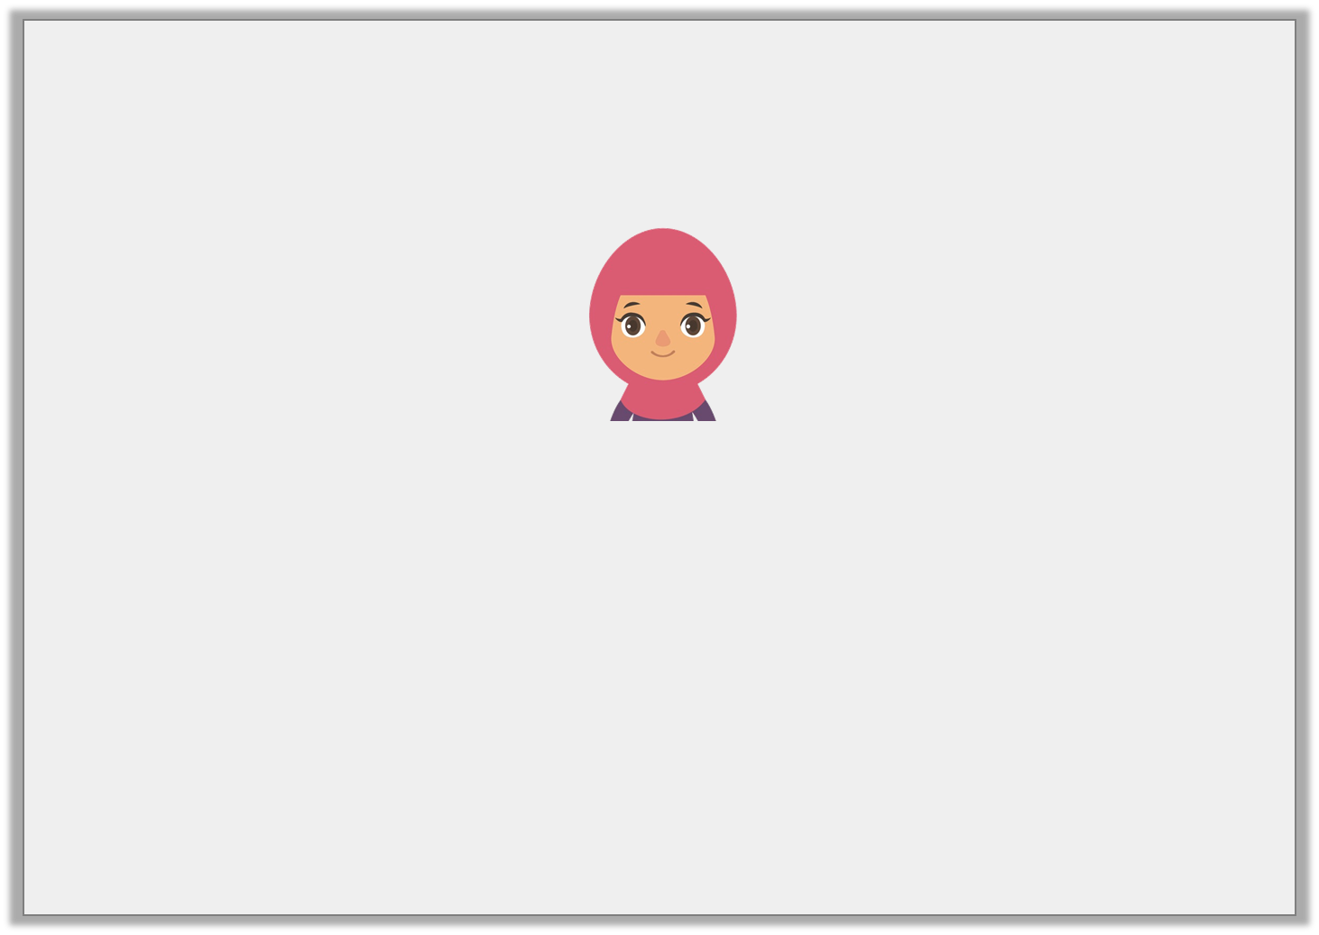
Reasoning 2
Alina has divided 92 by 10 on the
Gattegno chart below.
Is she correct? Convince me.
10 | 20 | 30 | 40 | 50 | 60 | 70 | 80 | 90
1 | 2 | 3 | 4 | 5 | 6 | 7 | 8 | 9
0.1 | 0.2 | 0.3 | 0.4 | 0.5 | 0.6 | 0.7 | 0.8 | 0.9
Y4
© Classroom Secrets Limited 2019

Slide 8
Reasoning 2
Alina has divided 92 by 10 on the
Gattegno chart below.
Is she correct? Convince me.
Alina is not correct because…
10 | 20 | 30 | 40 | 50 | 60 | 70 | 80 | 90
1 | 2 | 3 | 4 | 5 | 6 | 7 | 8 | 9
0.1 | 0.2 | 0.3 | 0.4 | 0.5 | 0.6 | 0.7 | 0.8 | 0.9
Y4
© Classroom Secrets Limited 2019

Slide 9
Reasoning 2
Alina has divided 92 by 10 on the
Gattegno chart below.
Is she correct? Convince me.
Alina is not correct because she has only moved the tens counter. The correct answer is 9.2
10 | 20 | 30 | 40 | 50 | 60 | 70 | 80 | 90
1 | 2 | 3 | 4 | 5 | 6 | 7 | 8 | 9
0.1 | 0.2 | 0.3 | 0.4 | 0.5 | 0.6 | 0.7 | 0.8 | 0.9
Y4
© Classroom Secrets Limited 2019

